Slide 1
Department of Computer Science
CS F364 – DESIGN AND ANALYSIS OF ALGORITHMS
LECTURE – DYNAMIC PROGRAMMING
PORTIONS: As specified in handout and the contents taught in class. Class notes is must. Refer to the textbook as mentioned in handout
PLEASE NOTE THAT PPT IS JUST AN ADDITIONAL REFERENCE.

Slide 2
Topic- Dynamic Programming
All Pair Shortest path

Slide 3
Introduction to DP
Dynamic Programming is a paradigm of algorithm design in which an optimization problem is solved by a combination of achieving sub-problem solutions and appearing to the "principle of optimality".

Slide 4
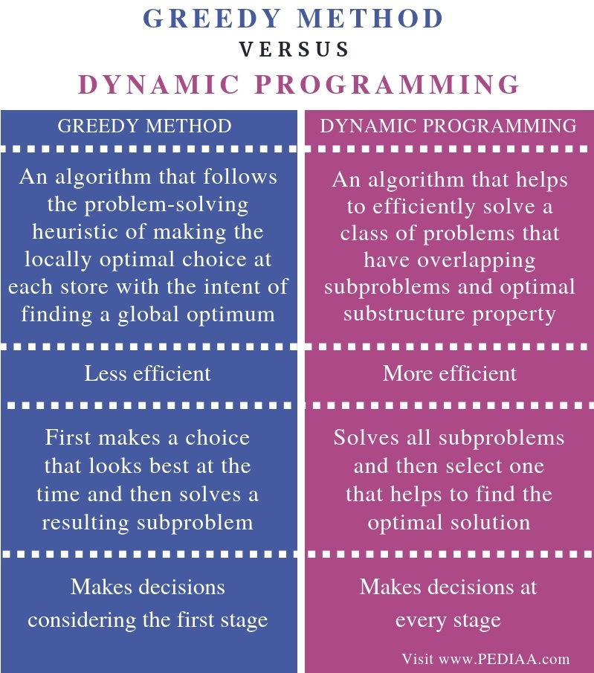

Slide 5


Slide 6




Principle of Optimality

Slide 7
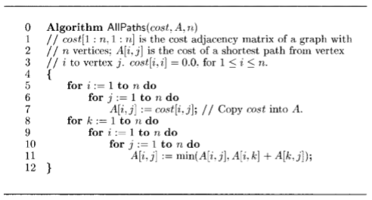
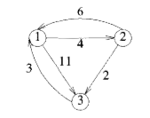
All pair shortest path

Slide 8
All pair Shortest Path
0(N^3)

Slide 9
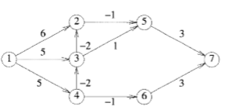
Single Source Shortest Path

Slide 10
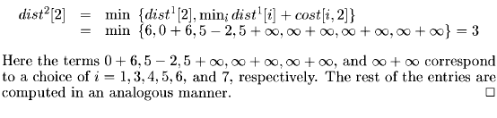
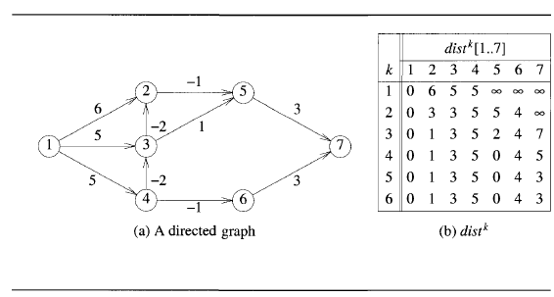

Slide 11
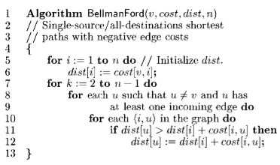
SSSP- BellmanFord

Slide 12
SSSP - Bellman Ford
0(N^3)

Slide 13
Thank you

